Slide 1
Event Based Approaches
Oxford University
Software Engineering Programme
December 2018

Slide 2
Why Asynchronous?

Slide 3
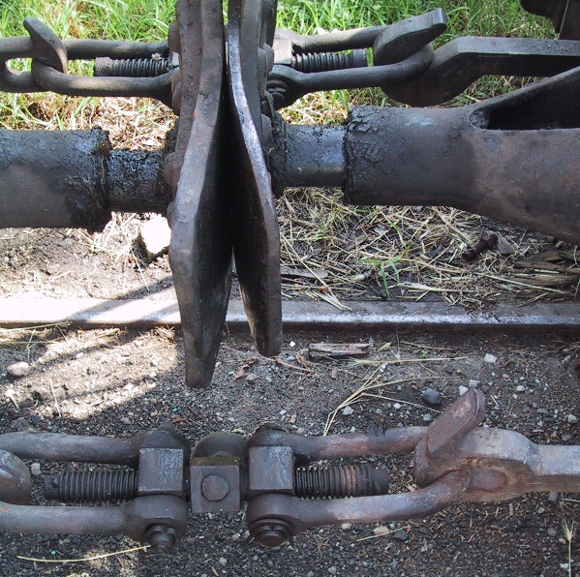
Loose coupling

Slide 4
Event Driven Architecture
Event Consumer
Event Producer
Event
Event Consumer

Slide 5
Loose coupling in EDA
Location
Logical addresses
Time
Asynchronous, Store/Forward, Replay
Message
JSON, XML, ProtoBuf, etc
Pattern
Pub/Sub, Queue, 1-1, 1-many, many-many, request-reply

Slide 6

EDA

Slide 7
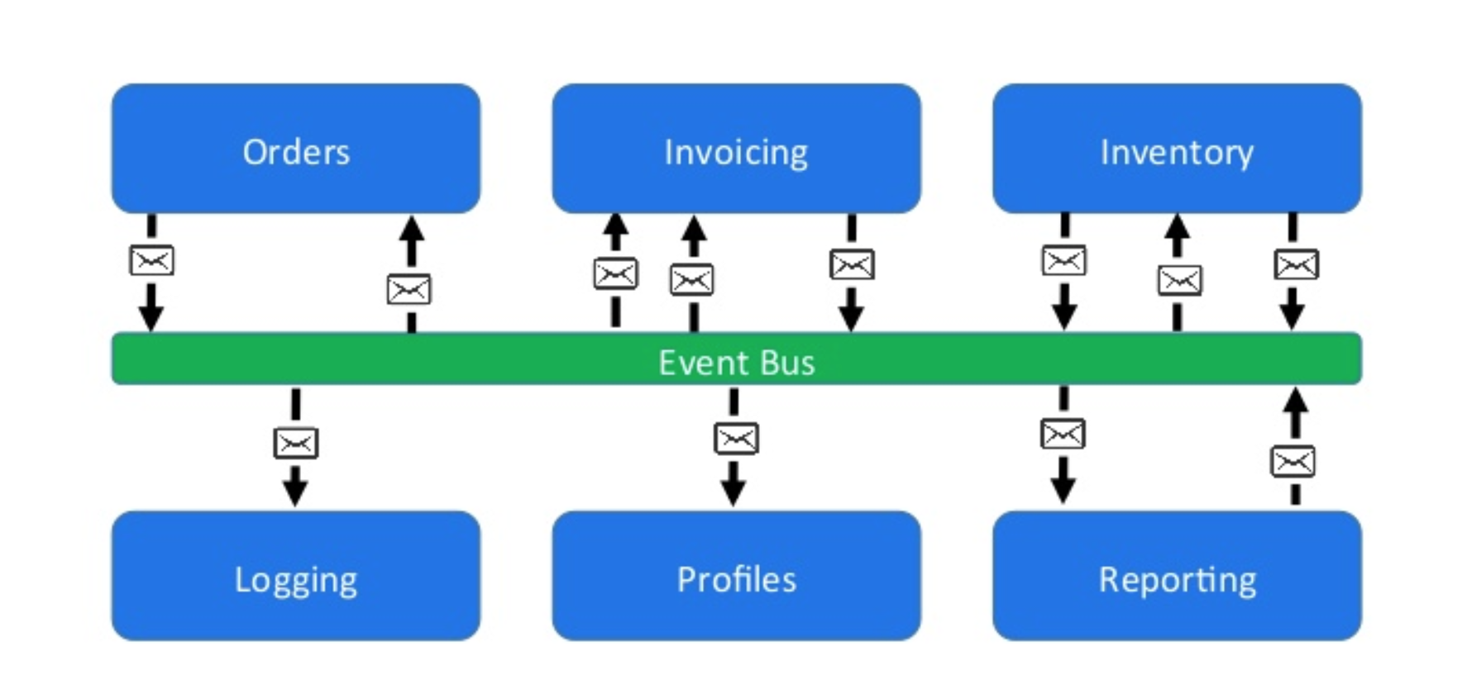
Loose coupling via event bus
https://www.slideshare.net/CentricConsulting/eventdriven-architecture-57613466

Slide 8
Message distribution systems
NATS
MQTT
STOMP
AMQP / RabbitMQ
Kafka

Slide 9
NATS
Simple text based protocol
Multiple patterns
Pure Pub/Sub
Request-Reply
Queuing
Clustered servers
Distributed queue across clusters
Cluster aware clients

Slide 10
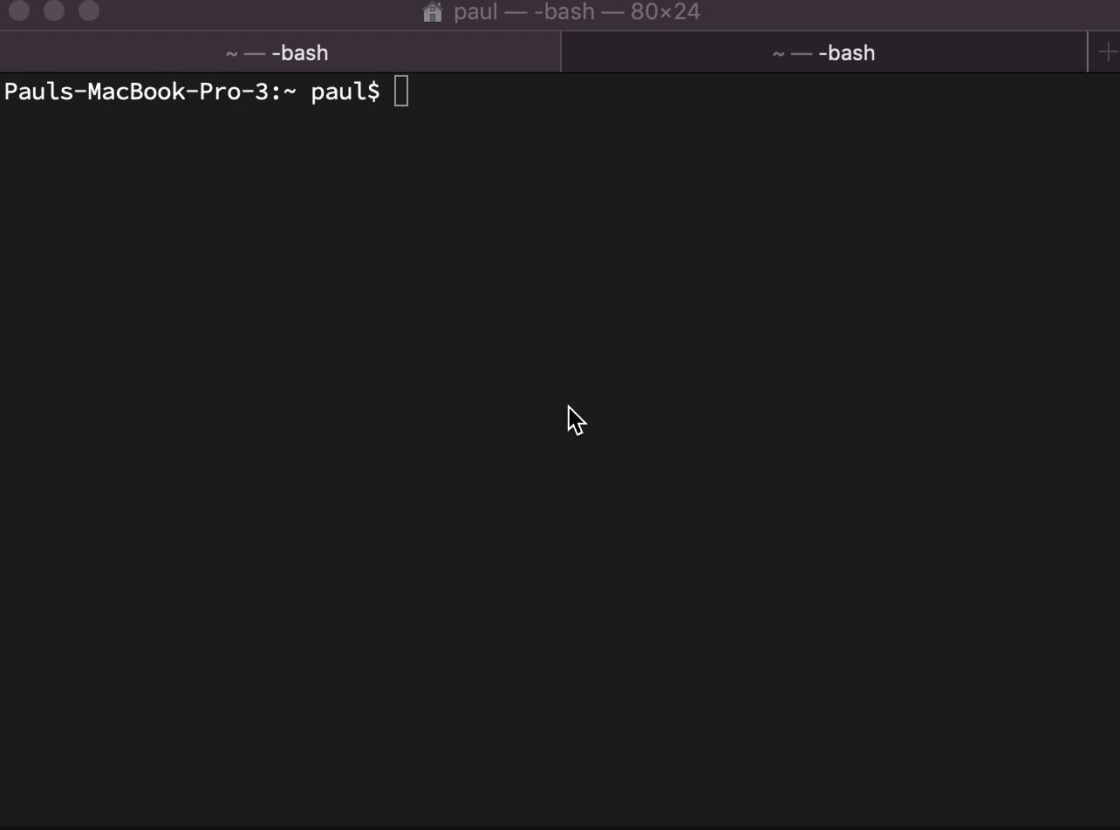
NATS simple demo

Slide 11
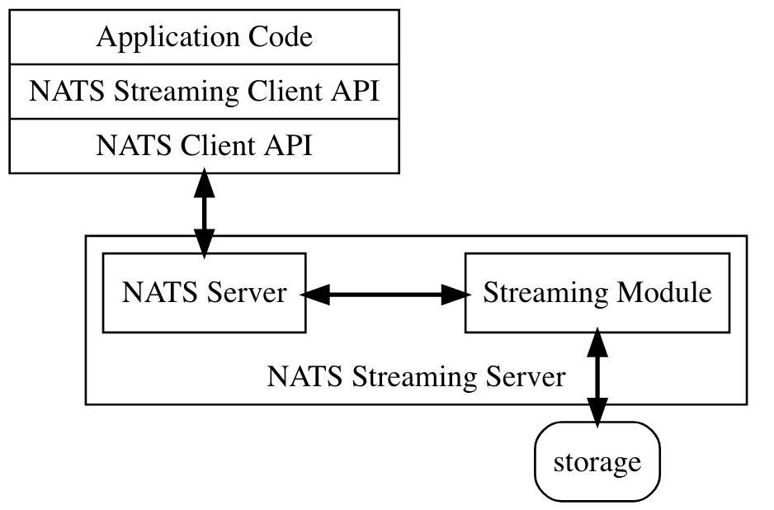
NATS Streaming

Slide 12
NATS Streaming
At least once delivery
Publisher rate limiting
Subscriber rate limiting
Message Replay
Durable Subscriptions

Slide 13
MQTT
Very lightweight binary protocol
2-byte overhead
Widely used in IoT scenarios
Pub-sub only until MQTT5
QoS levels
Fire and forget QoS0
At least once QoS1
Exactly once QoS2

Slide 14
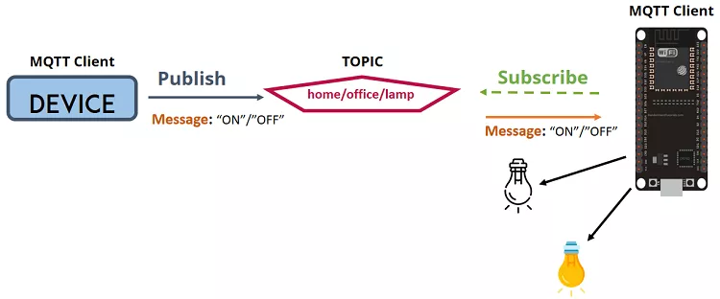
MQTT

Slide 15
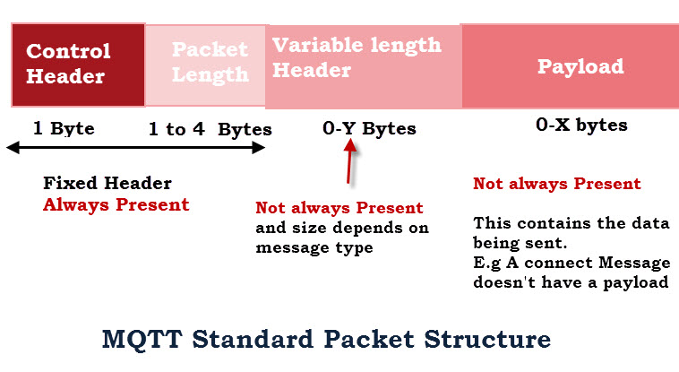
MQTT Packets http://www.steves-internet-guide.com/mqtt-protocol-messages-overview/

Slide 16
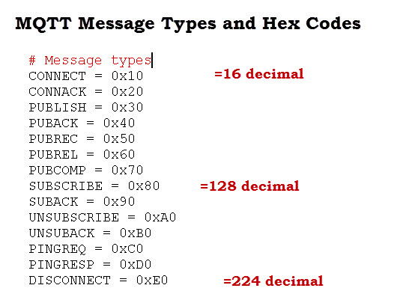

Slide 17
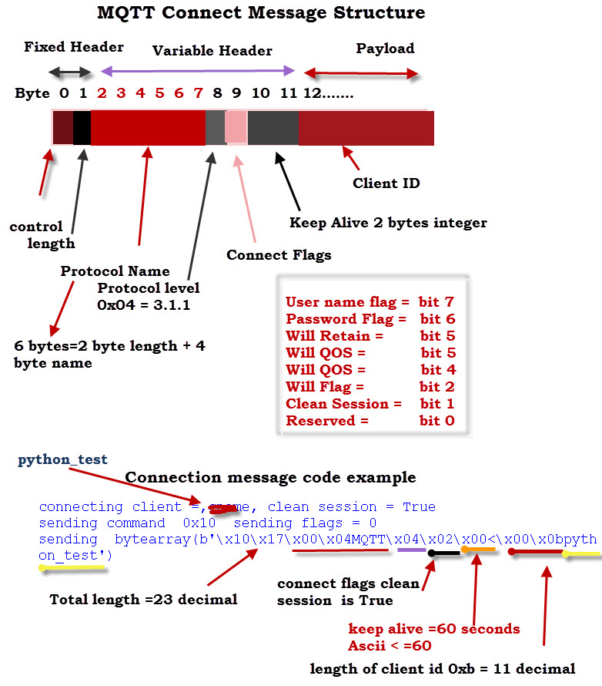

Slide 18

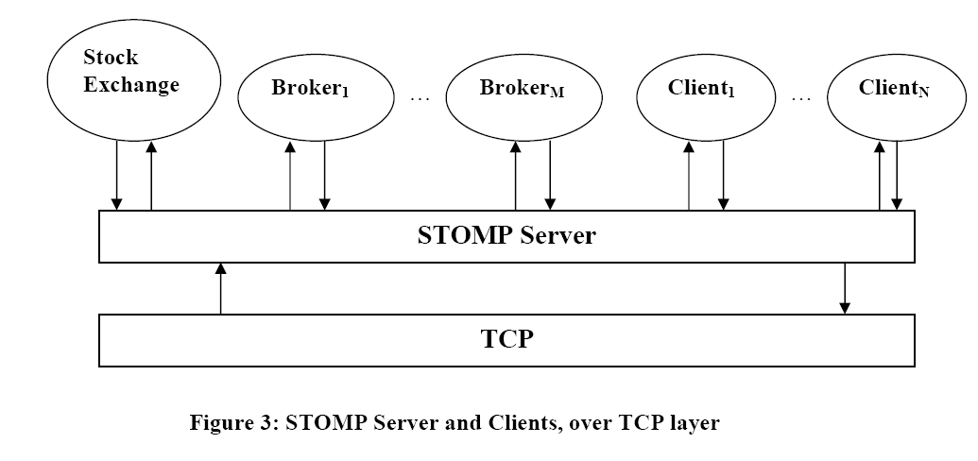
STOMP

Slide 19
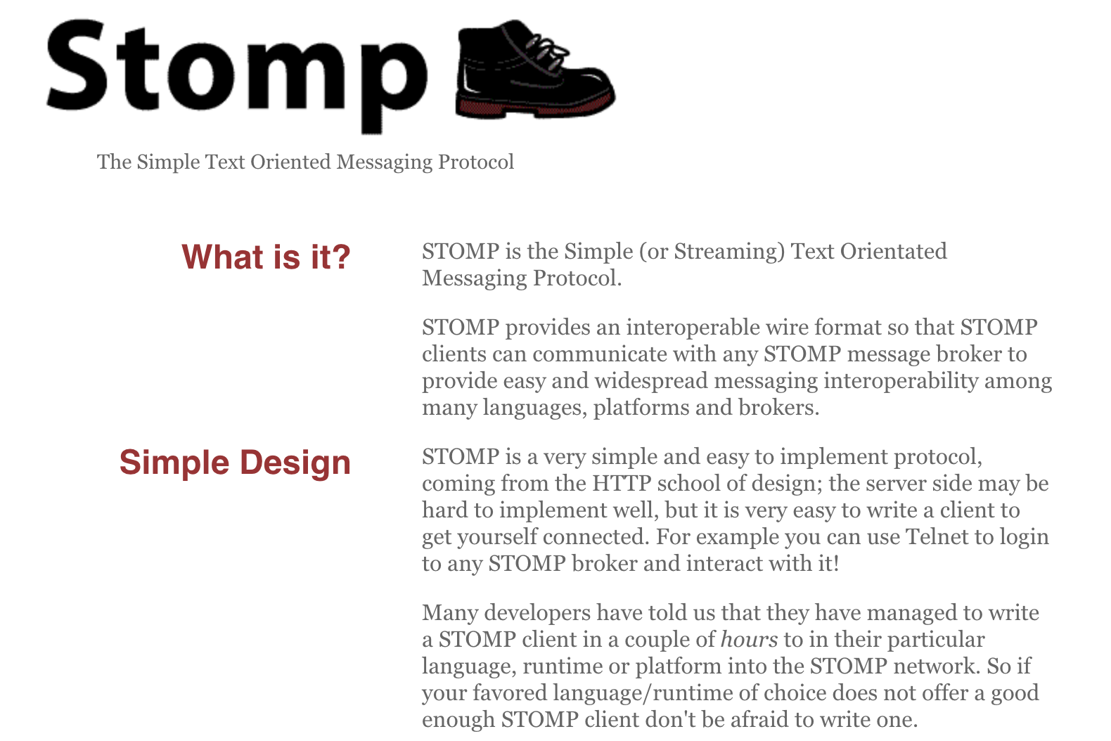

Slide 20
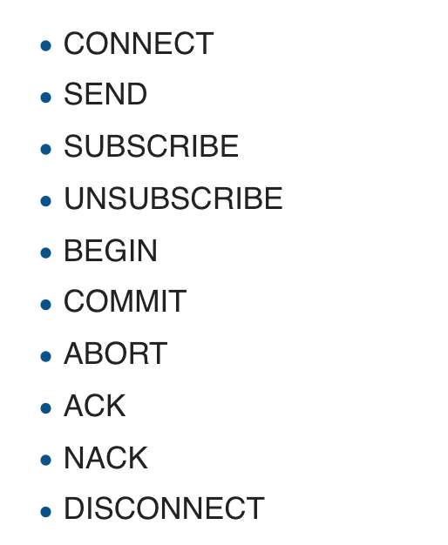
STOMP “verbs”

Slide 21
AMQP / RabbitMQ
AMQP is an advanced messaging protocol
Designed to meet more enterprise needs
Emerged from JP Morgan attempting to decouple from proprietary systems
Standardised in OASIS
Although many implementations prefer 0-91 to 1-00

Slide 22
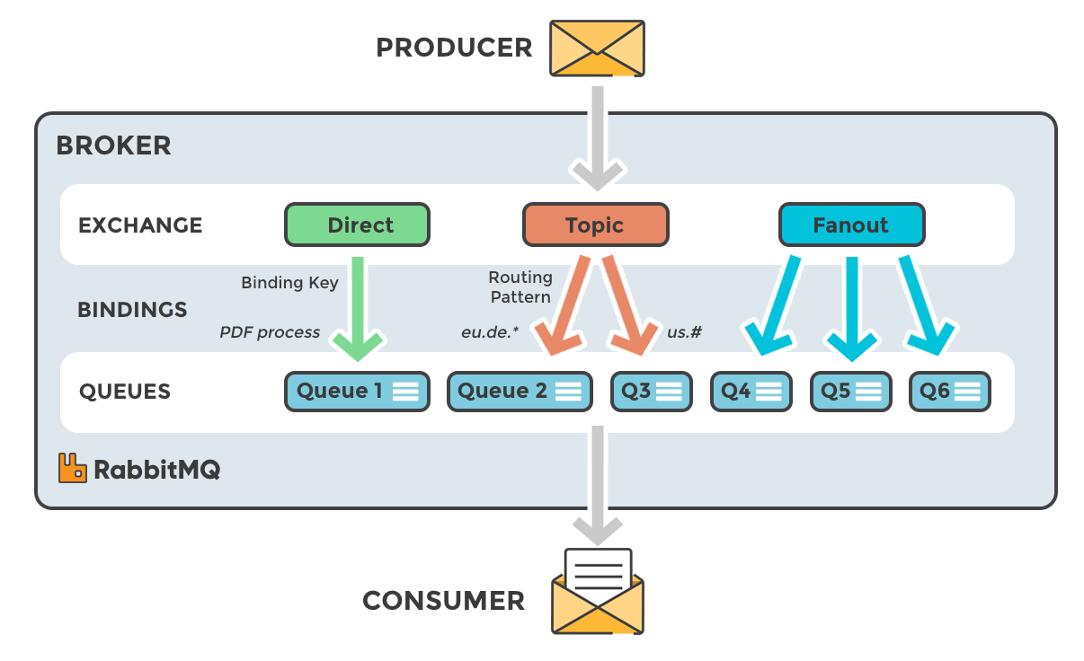

Slide 23
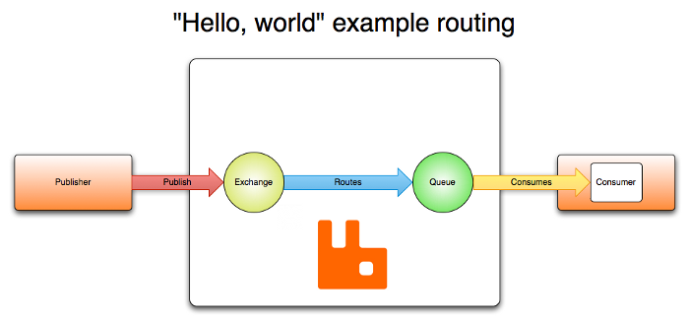
RabbitMQ

Slide 24
RabbitMQ
Written in Erlang
Designed to implement the AMQP 0-91 spec
Now extended to support STOMP, MQTT, AMQP 1-0 and HTTP
Clusterable and high-performance
Transactional

Slide 25
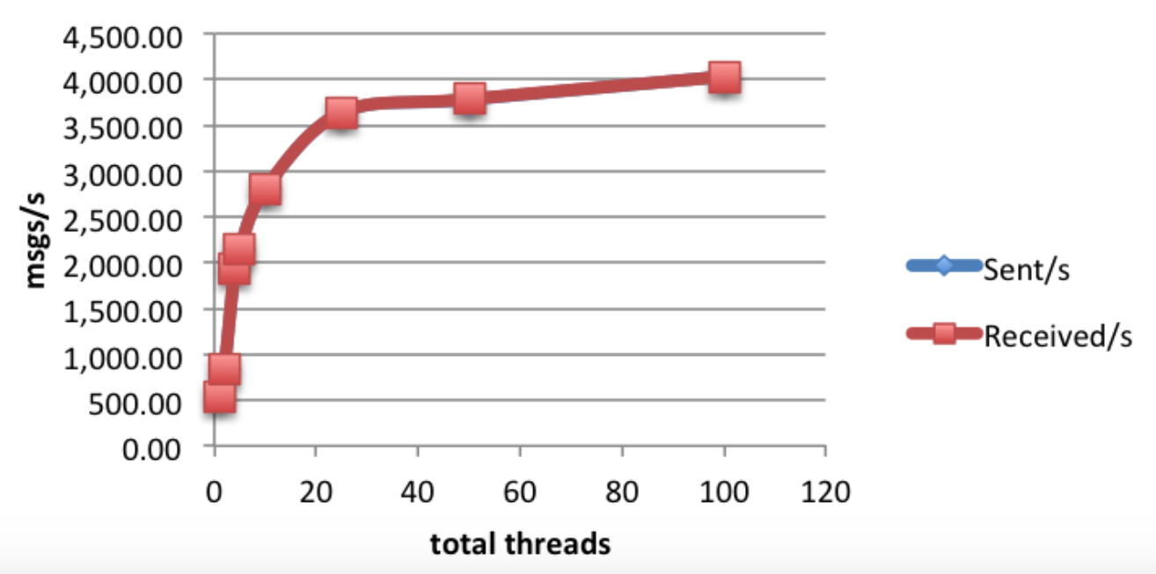
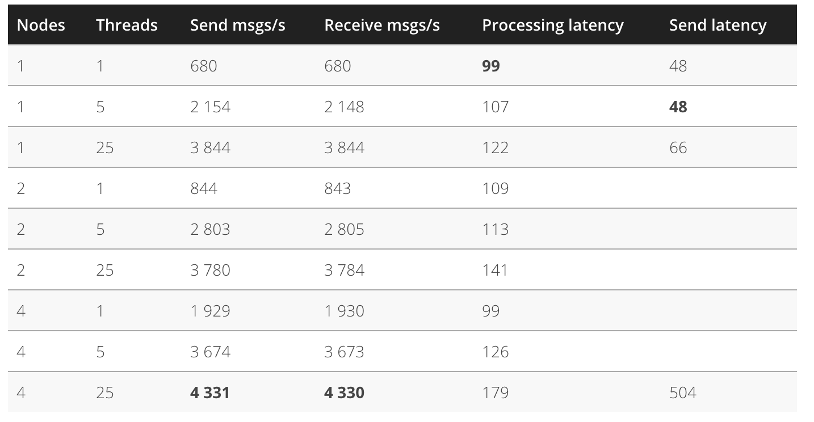
RabbitMQ performance https://softwaremill.com/mqperf/

Slide 26
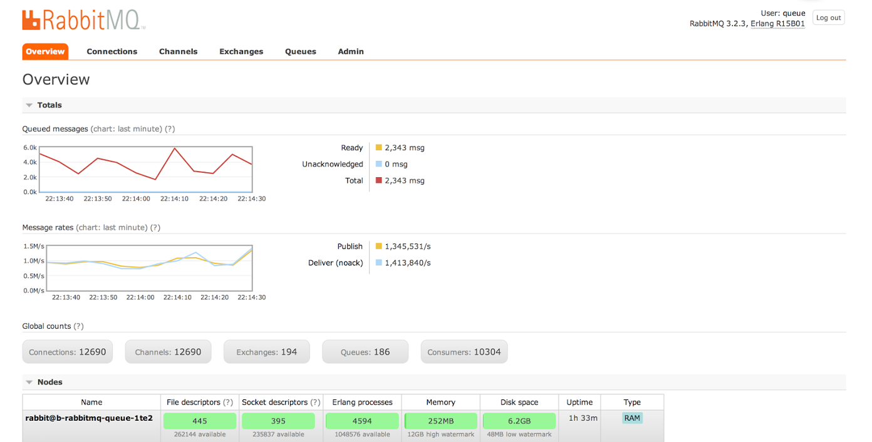
>1m msgs/sec https://content.pivotal.io/blog/rabbitmq-hits-one-million-messages-per-second-on-google-compute-engine

Slide 27
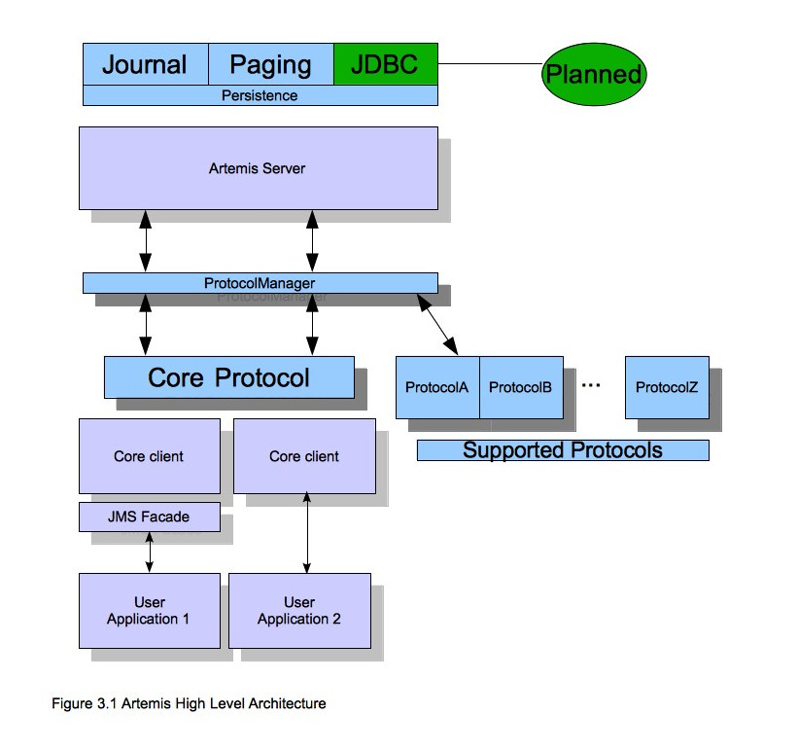
ActiveMQ / Artemis

Slide 28
Artemis
Supports multi-protocols:
“JMS”, AMQP, STOMP, OpenWire, MQTT, REST
Highly available and clusterable
Written in Java

Slide 29
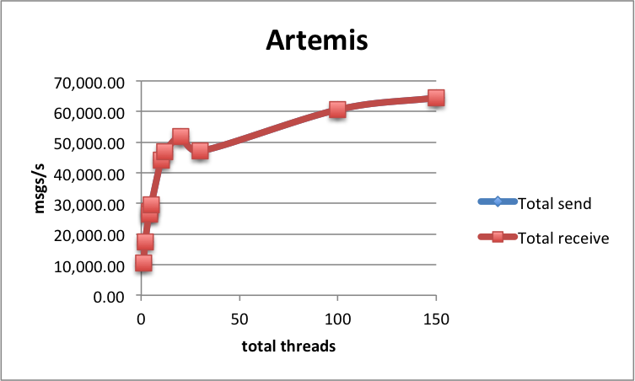
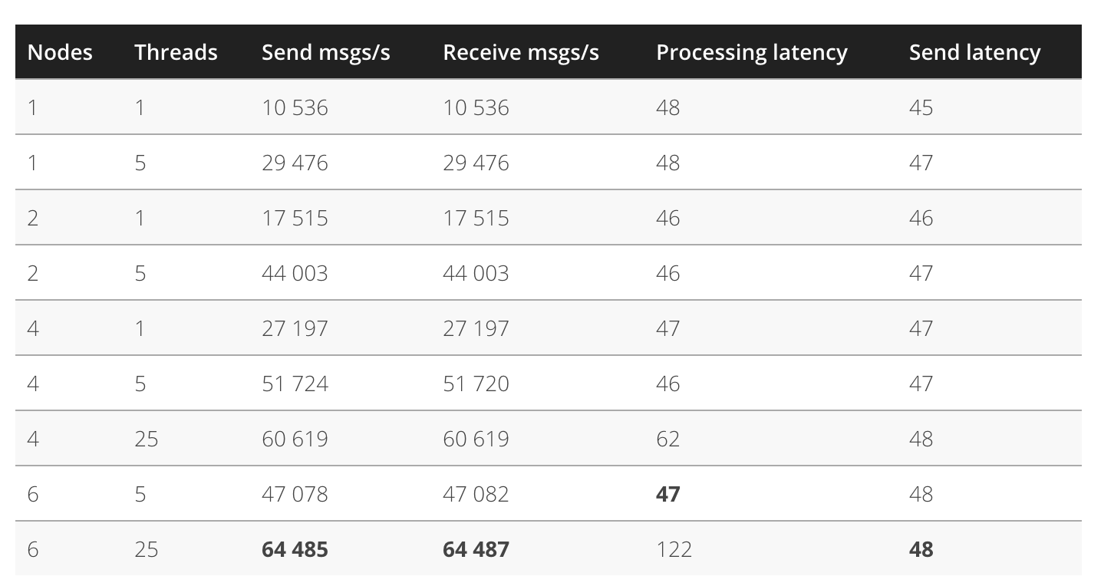
Artemis Performance https://softwaremill.com/mqperf/

Slide 30
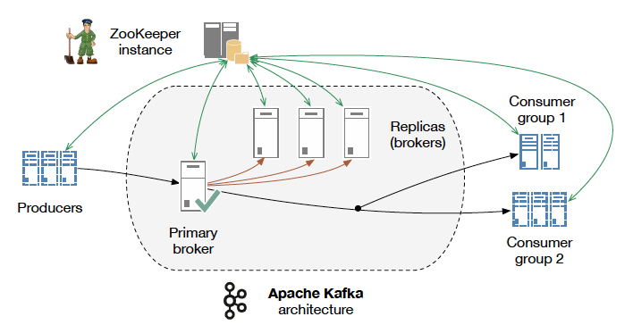
Apache Kafka

Slide 31
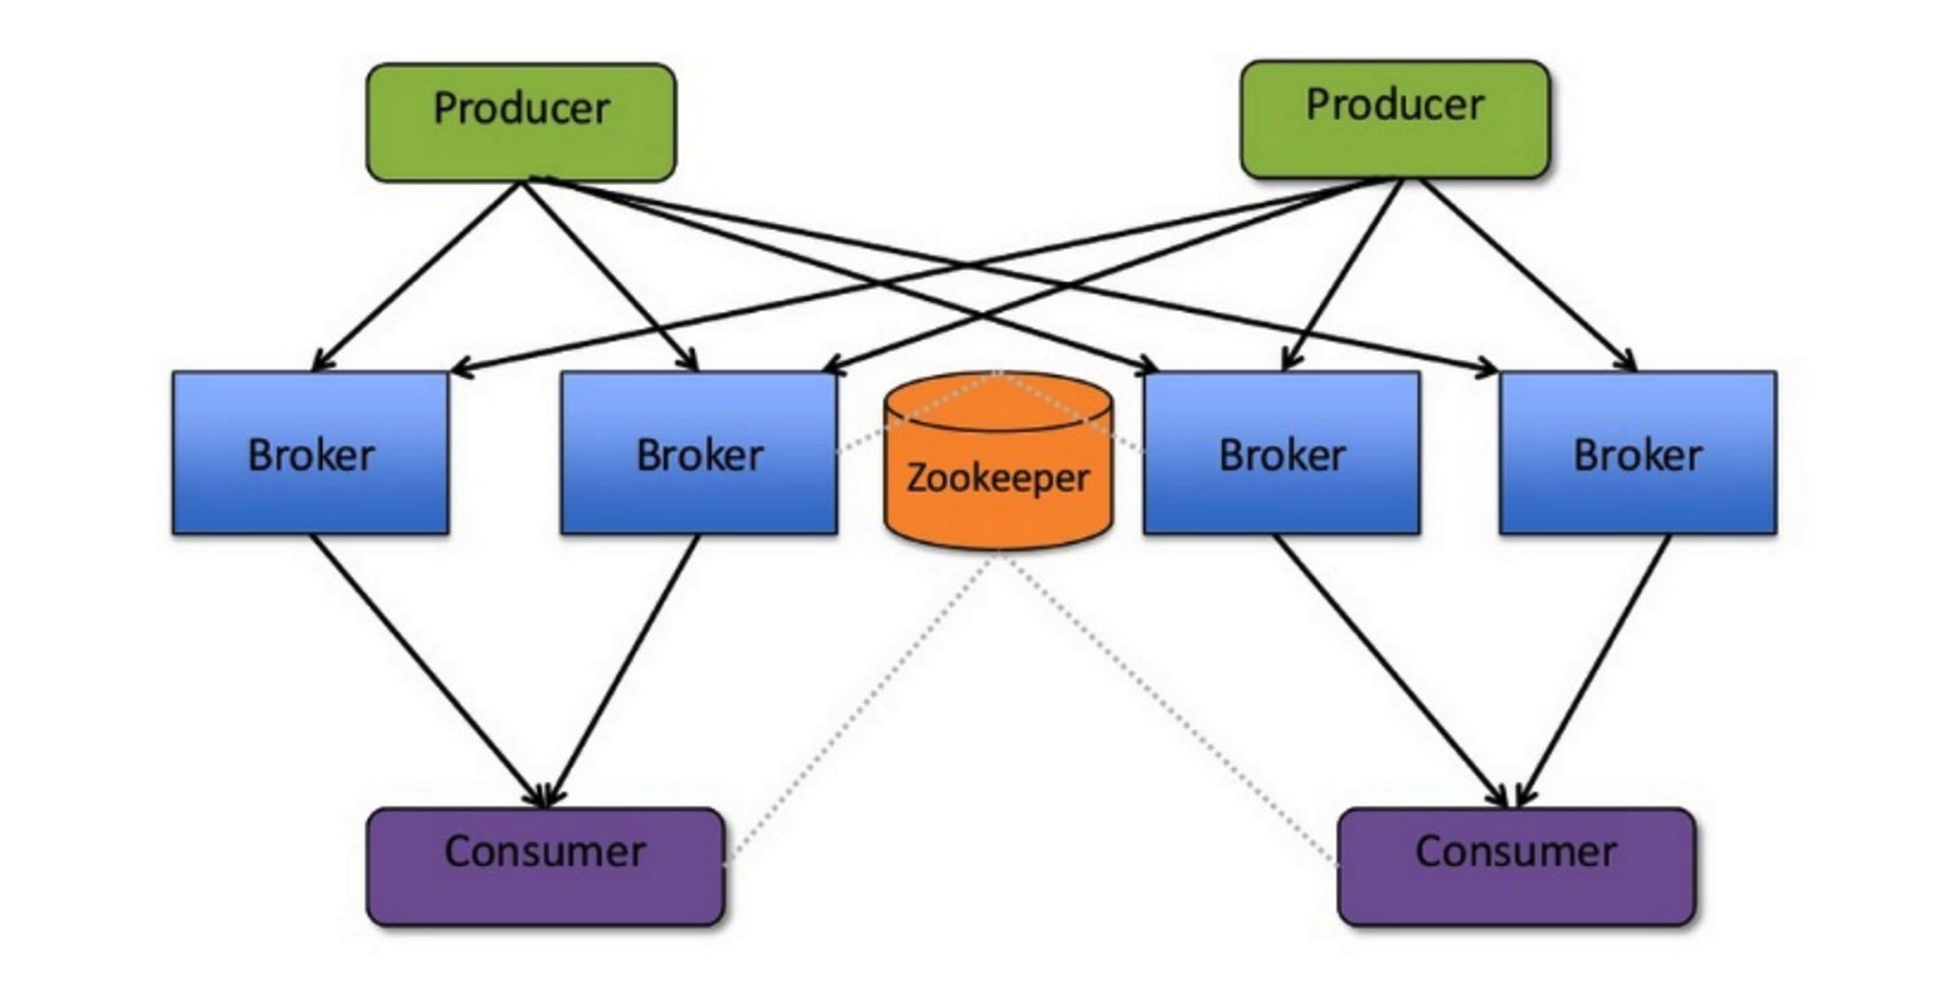
Apache Kafka
Source: http://www.slideshare.net/charmalloc/

Slide 32
Kafka
Applying “big data” approaches to messaging:
Partitioning
Multiple brokers
Elastically scalable
Supports clusters of co-ordinated consumers
Automatic re-election of leaders

Slide 33
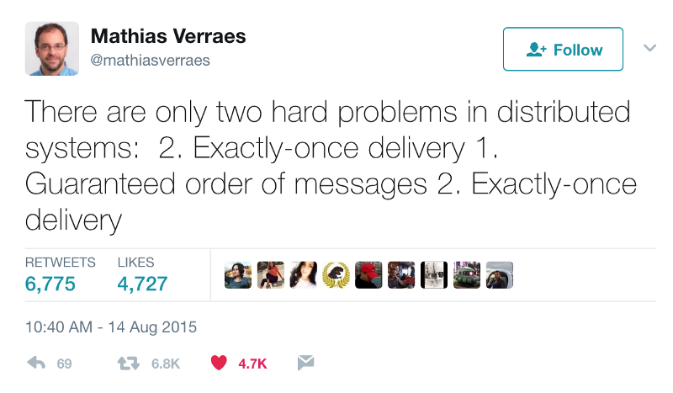
Kafka exactly-once semantics

Slide 34
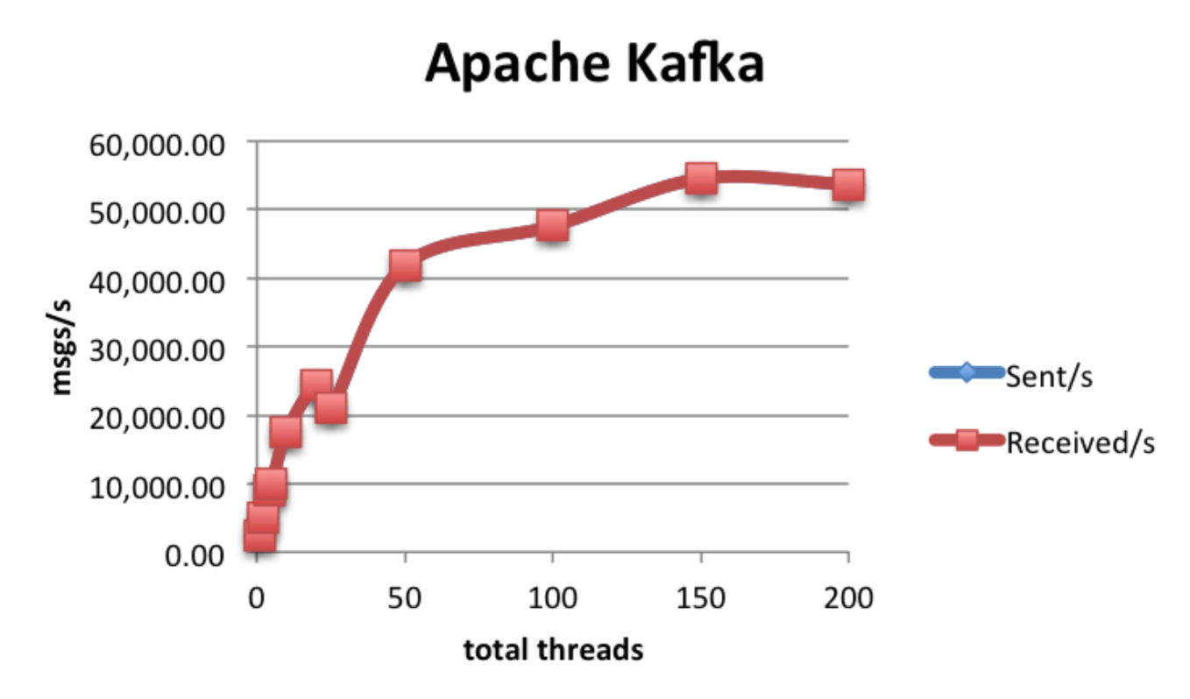
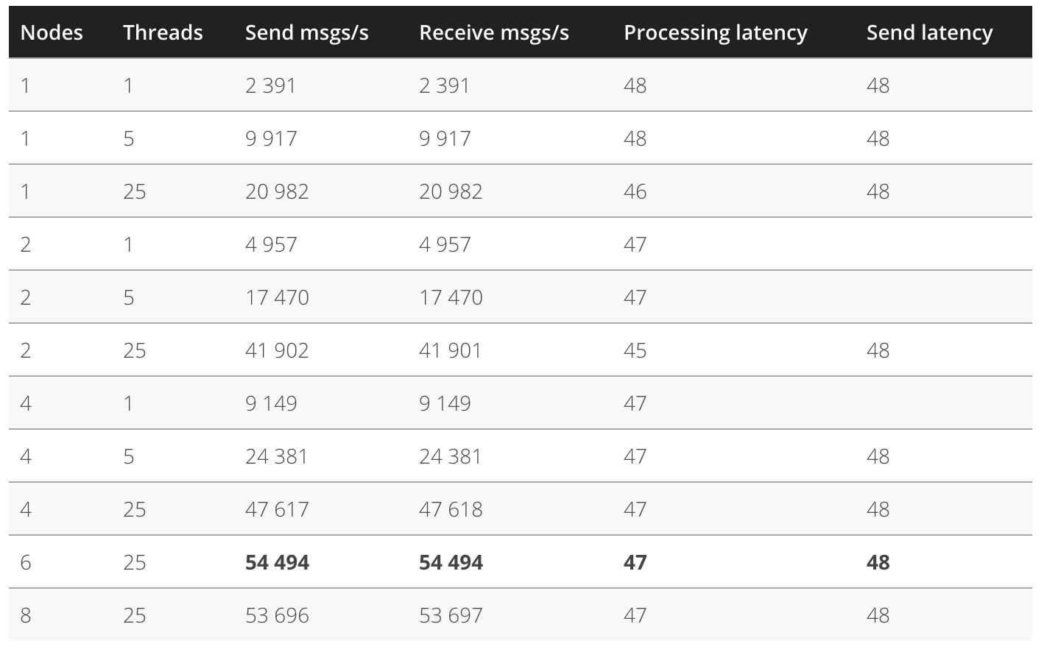
Kafka Performance

Slide 35
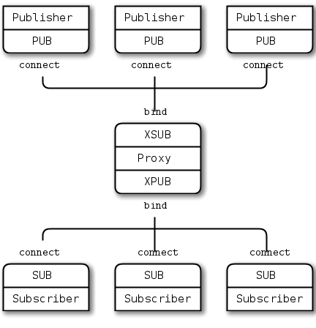
ZeroMQ

Slide 36
Streaming
Continuous data flow
“Unbounded streams of data”
Usually uses a message distribution system
JMS
Apache Kafka
MQTT
Etc
An unbounded set of events with time
<t1, E1>, <t2, E2>, ….., <tn, En>, ....

Slide 37
Stream processing categorization
Simple event processing
Working on an event at a time
e.g. filter out all events where the wind speed > 50 mph
Event stream processing
Time-based processing of a single stream of events
Average wind speed over the last hour compared to the average over the last day
Complex Event Processing
Correlation of events across different streams
Emergency calls correlated with wind speed in real time

Slide 38
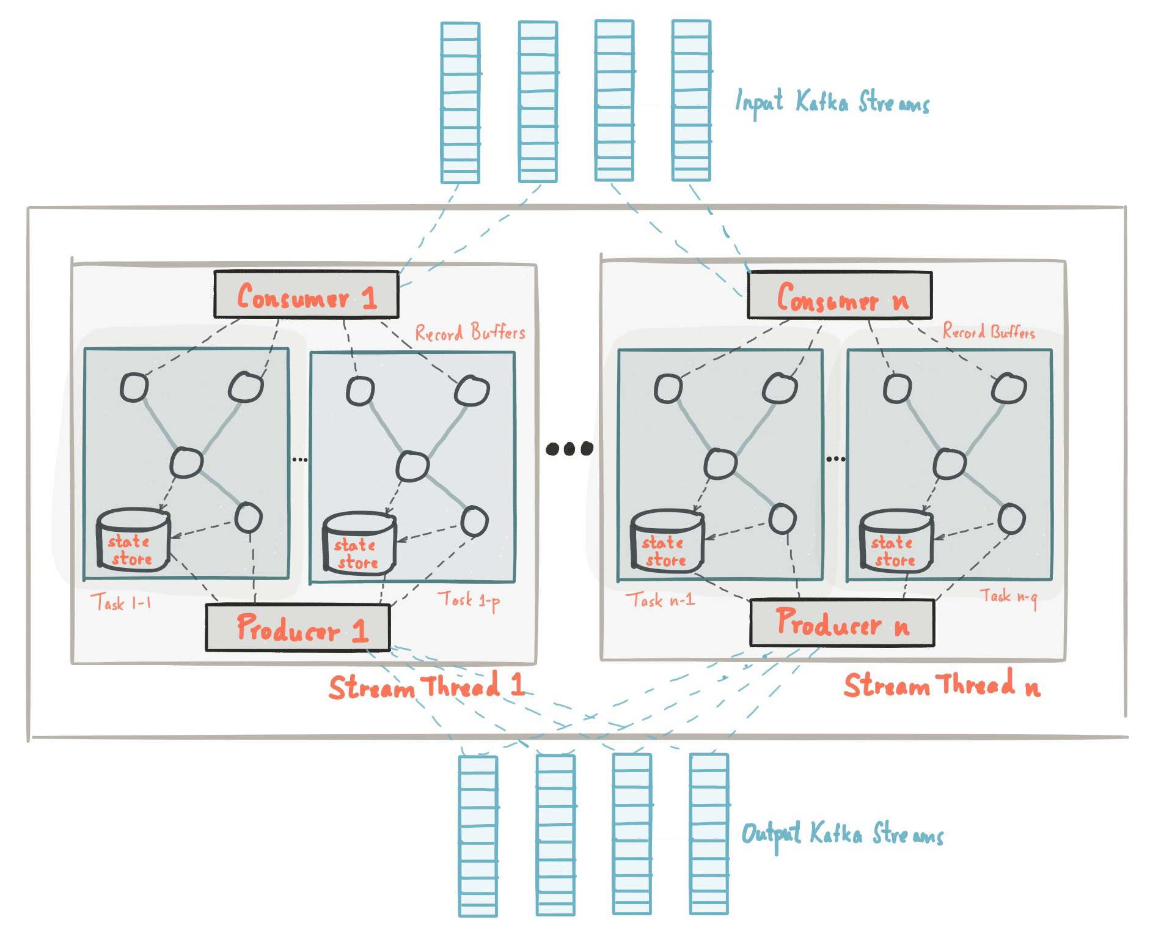
Kafka Streams

Slide 39
Kafka Streams
Event-at-a-time processing (not microbatch) with millisecond latency
Stateful processing including distributed joins and aggregations
A convenient DSL
Windowing with out-of-order data using a DataFlow-like model
Distributed processing and fault-tolerance with fast failover
Reprocessing capabilities so you can recalculate output when your code changes
No-downtime rolling deployments

Slide 40
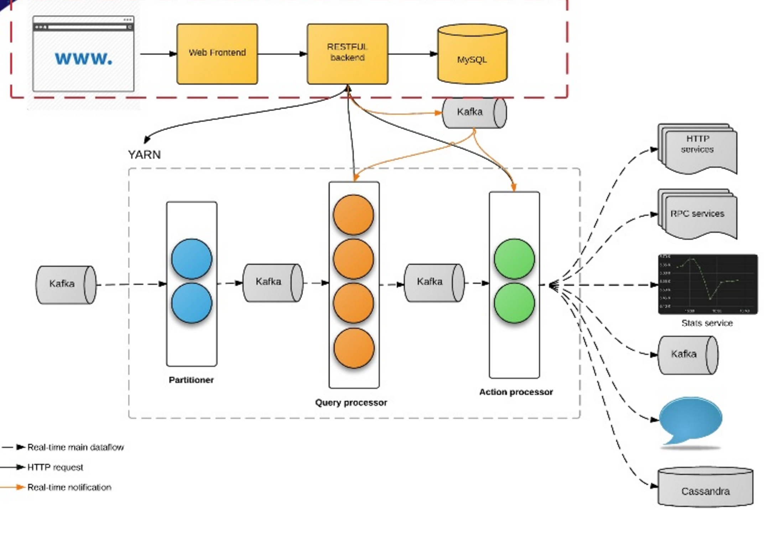
Siddhi at Uber

Slide 41
Siddhi at Uber
100+ production apps
30 billion messages / day
Fraud, anomaly detection
Marketing, promotion
Monitoring, feedback
Real time analytics and visualization
https://freo.me/siddhi-uber

Slide 42
Siddhi
A stateful query model
SQL-like language for querying streams of data
Extended with windows
Time, Event count, batches
Partitioned
Based on data in the events
Pattern matching
A then B then C within window

Slide 43
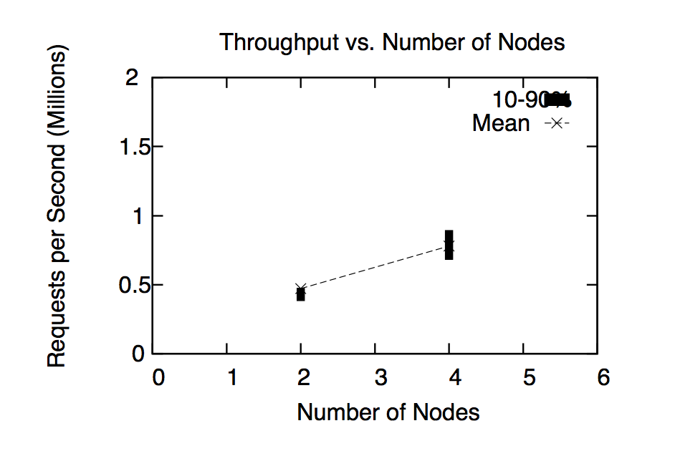
Siddhi
Apache Licensed Open Source on Github
https://github.com/wso2/siddhi/
Pluggable into Storm, Spark and Kafka Streams
Supports millions of events/sec
http://freo.me/DEBS_Siddhi

Slide 44
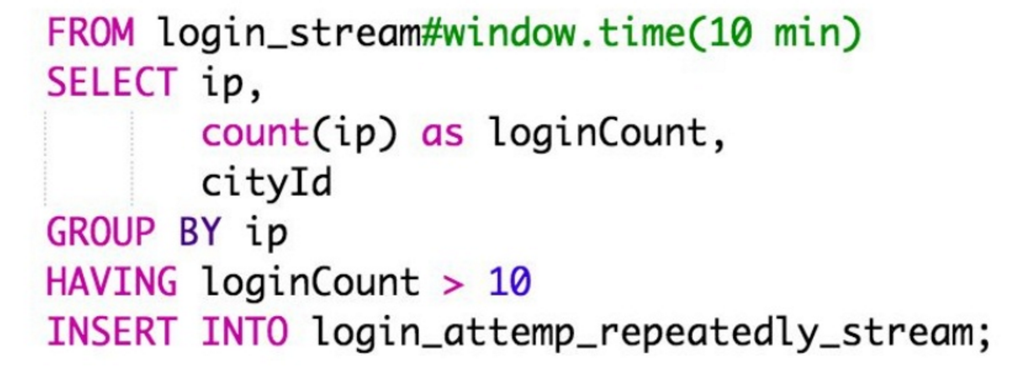
SiddhiQL

Slide 45
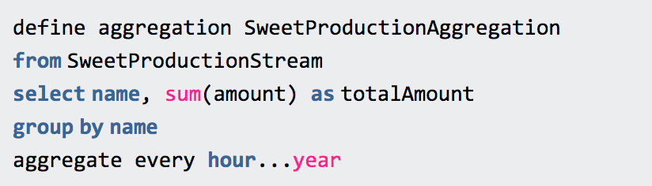
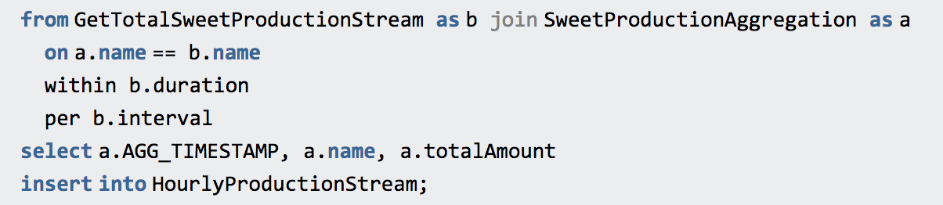
Long-running aggregation

Slide 46
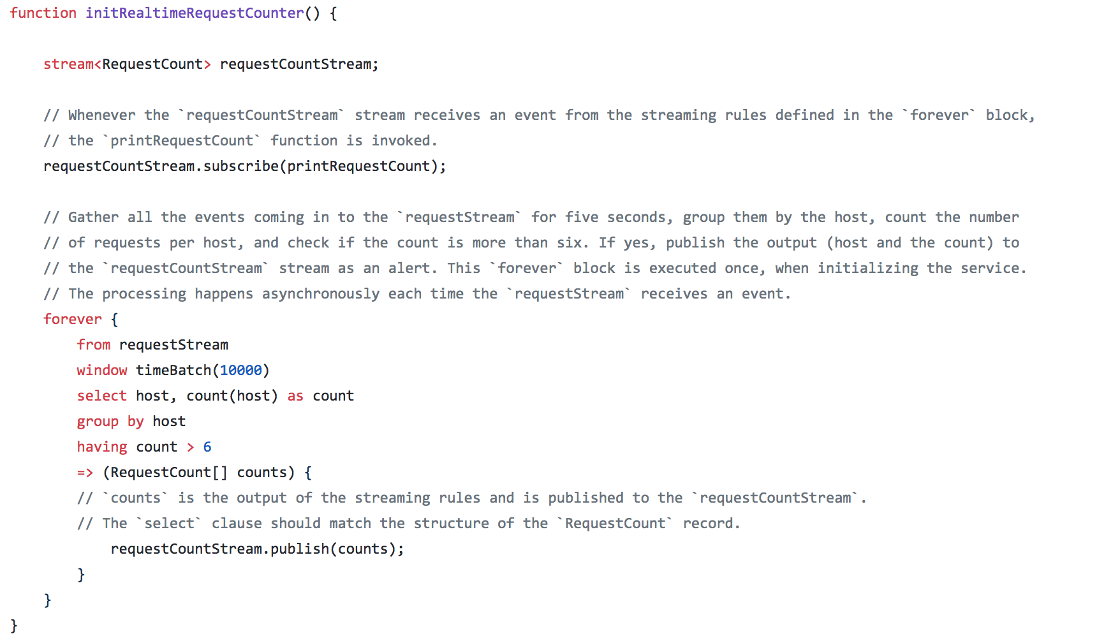
Streaming in Ballerina

Slide 47
Questions?

